Slide 1
Wireless Communications
Principles and Practice
2/e
T.S. Rapppaport
Chapter 6: Modulation Techniques for Mobile Radio

Slide 2
Analog and Digital Modulation, Line Coding, AM/FM/SSB

Slide 3
Digital Fundamentals:
The Sampling Theorem, Nyquist Sampling

Slide 4
Key Digital Modulation Techniques:
BPSK, OFDM, GMSK

Slide 5
Spread Spectrum:
DS-SS, FH-SS, Coding Gain, Fading Margins

Slide 6
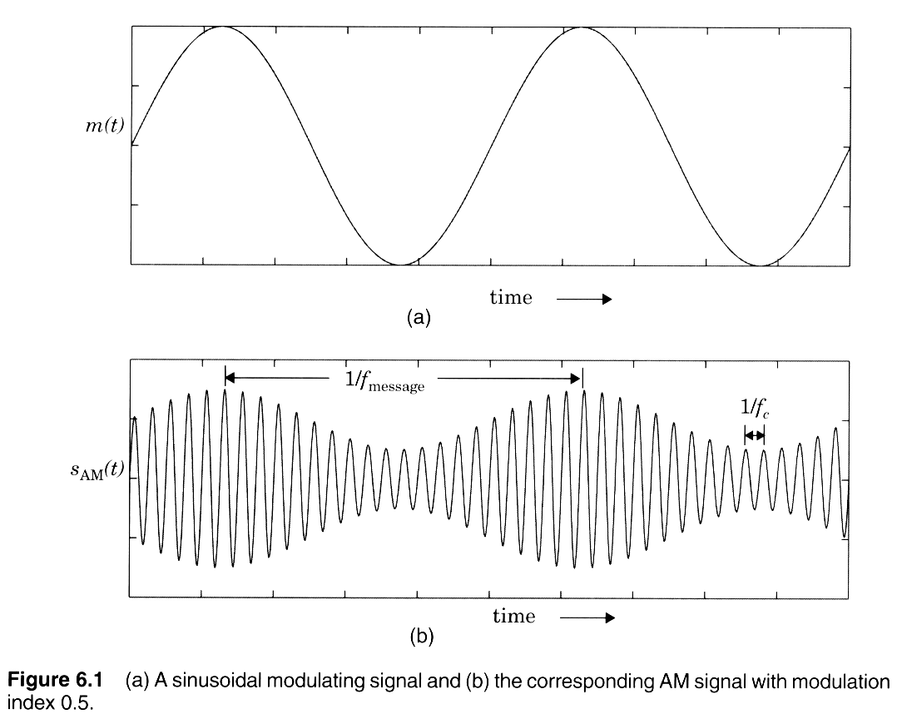
Amplitude Modulation

Slide 7
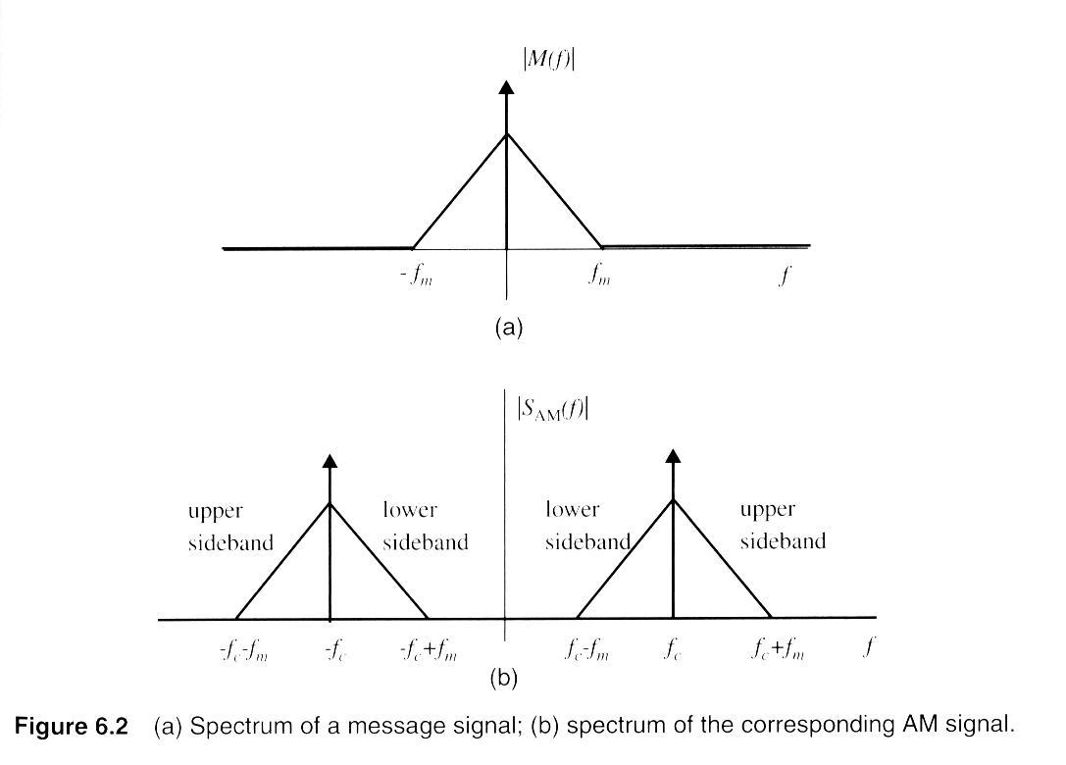
Double Sideband Spectrum
Notes:
Fig. 3.2

Slide 8
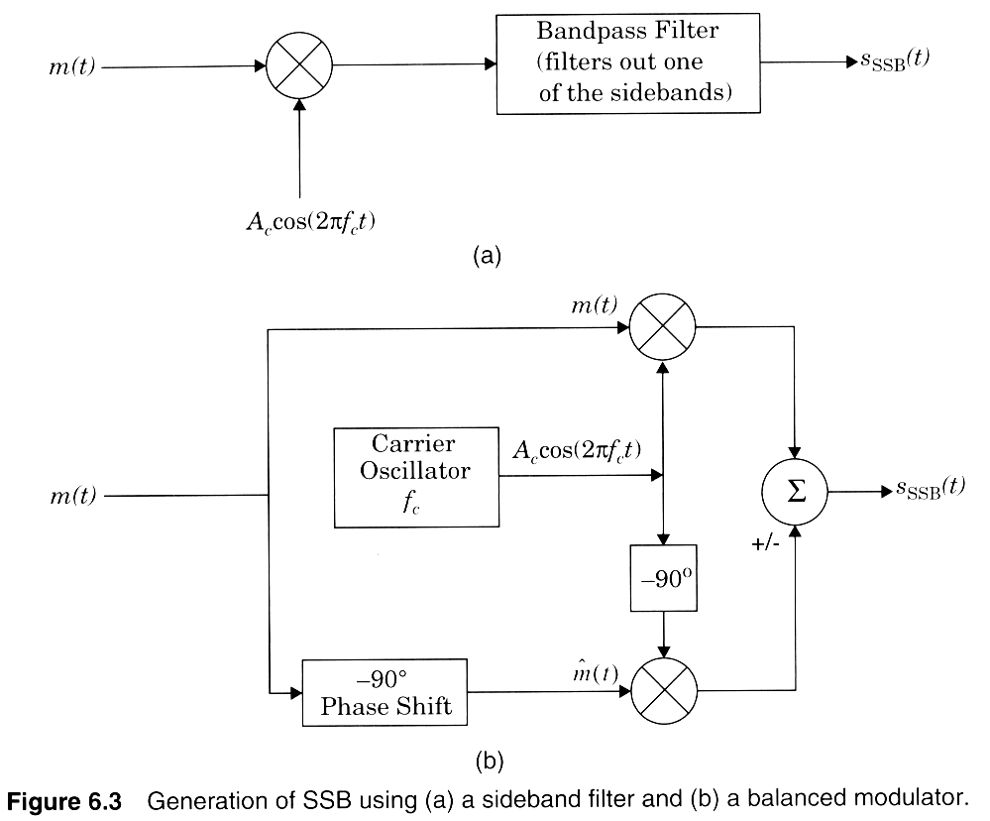
SSB Modulators

Slide 9
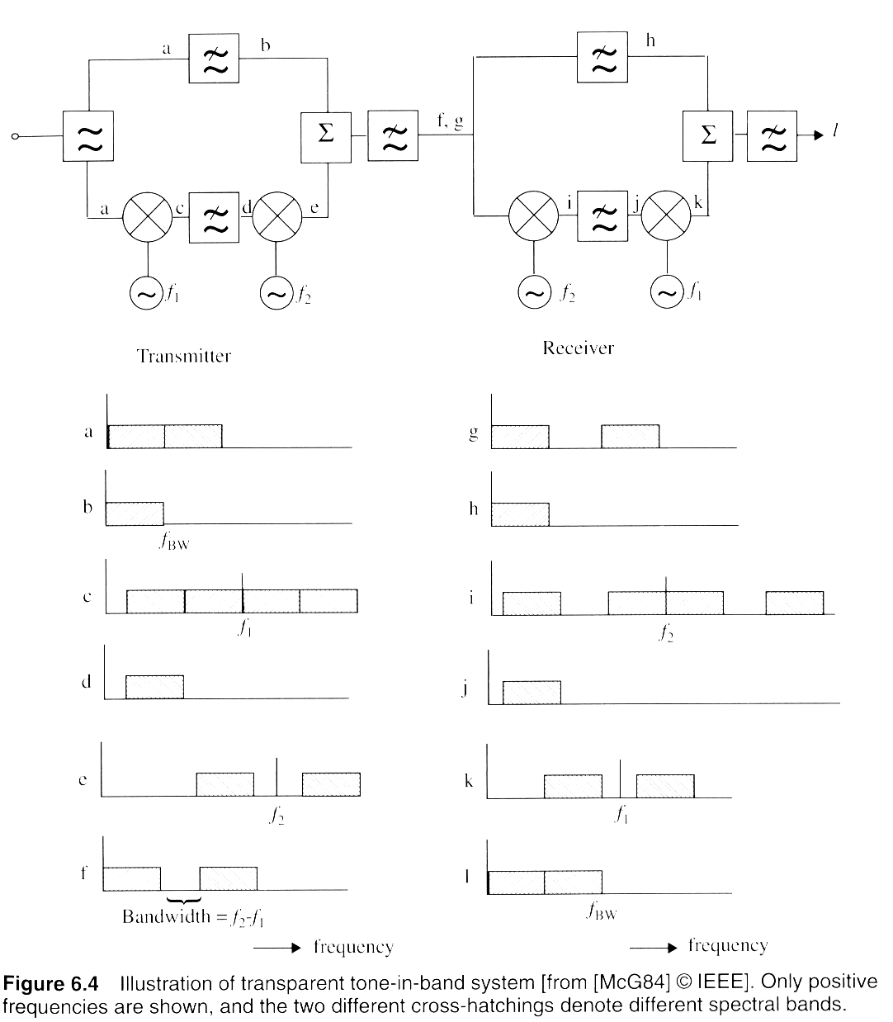
Tone-in Band SSB
Notes:
Fig. 2.3

Slide 10
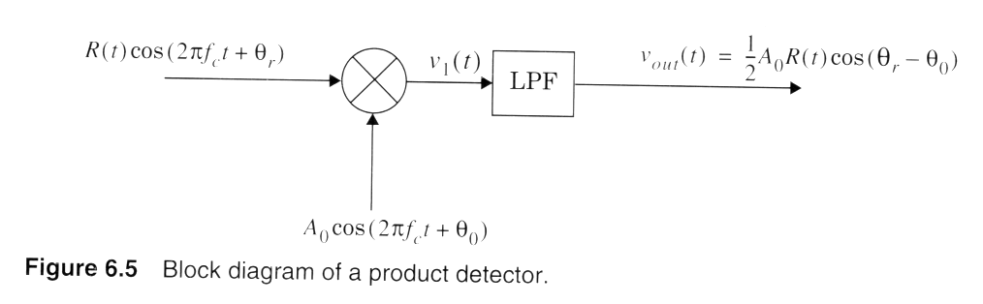
Product Detection

Slide 11
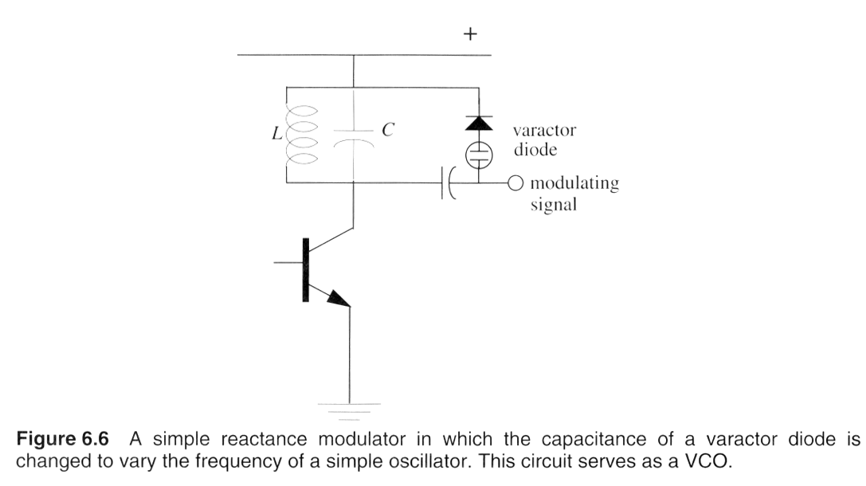
VCO circuit

Slide 12
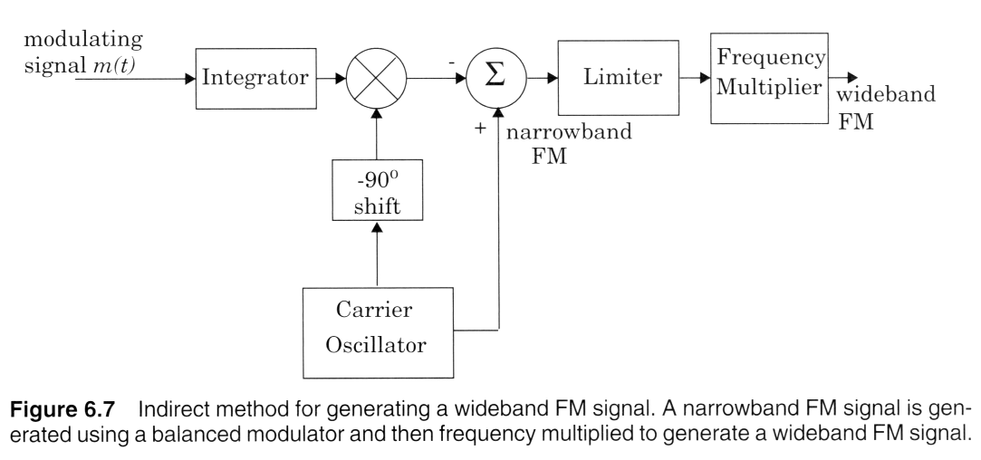
Wideband FM generation
Notes:
Fig. 2.4

Slide 13
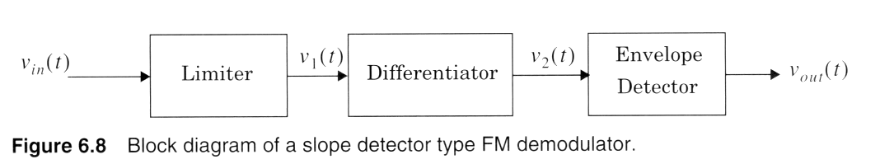
Slope Detector for FM
Notes:
Fig. 2.5

Slide 14
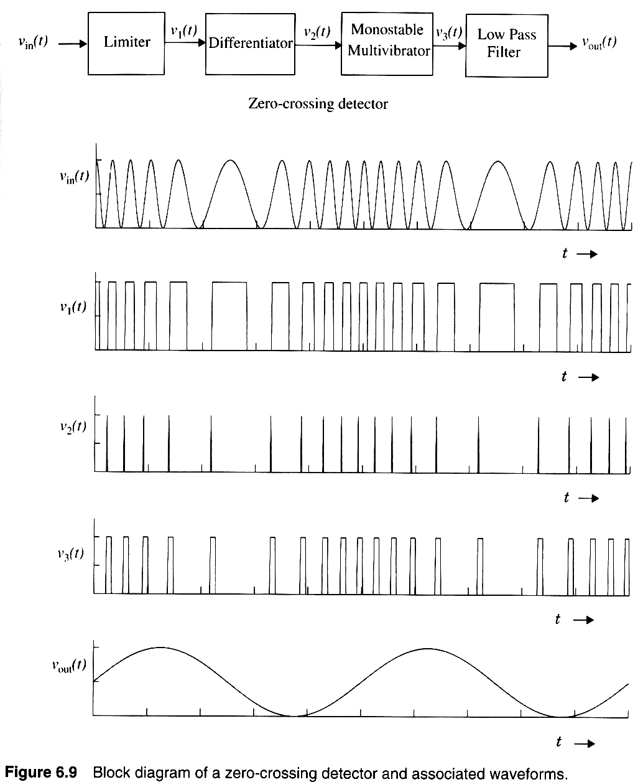
Digital Demod for FM
Notes:
Fig. 2.6

Slide 15
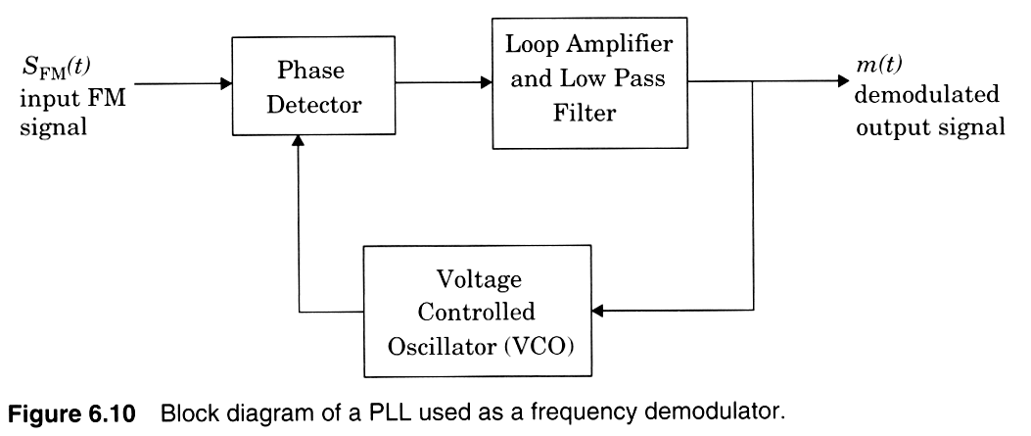
PLL Demod for FM
Notes:
Fig. 2.7

Slide 16
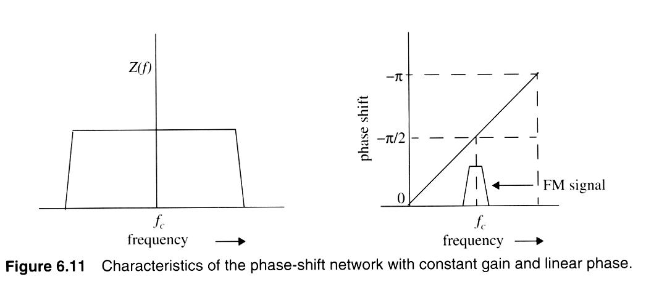
Phase-shift quadrature FM demod
Notes:
Fig. 2.8

Slide 17
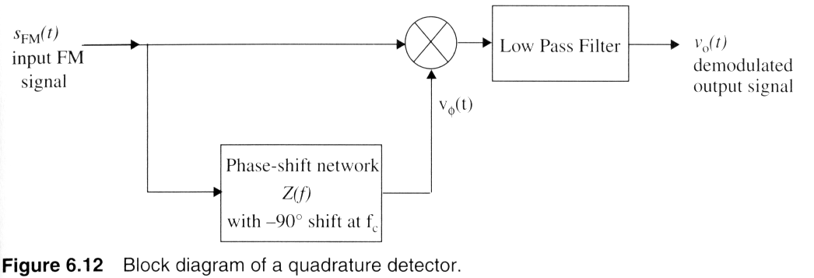
FM Demod circuit
Notes:
Fig. 2.9

Slide 18
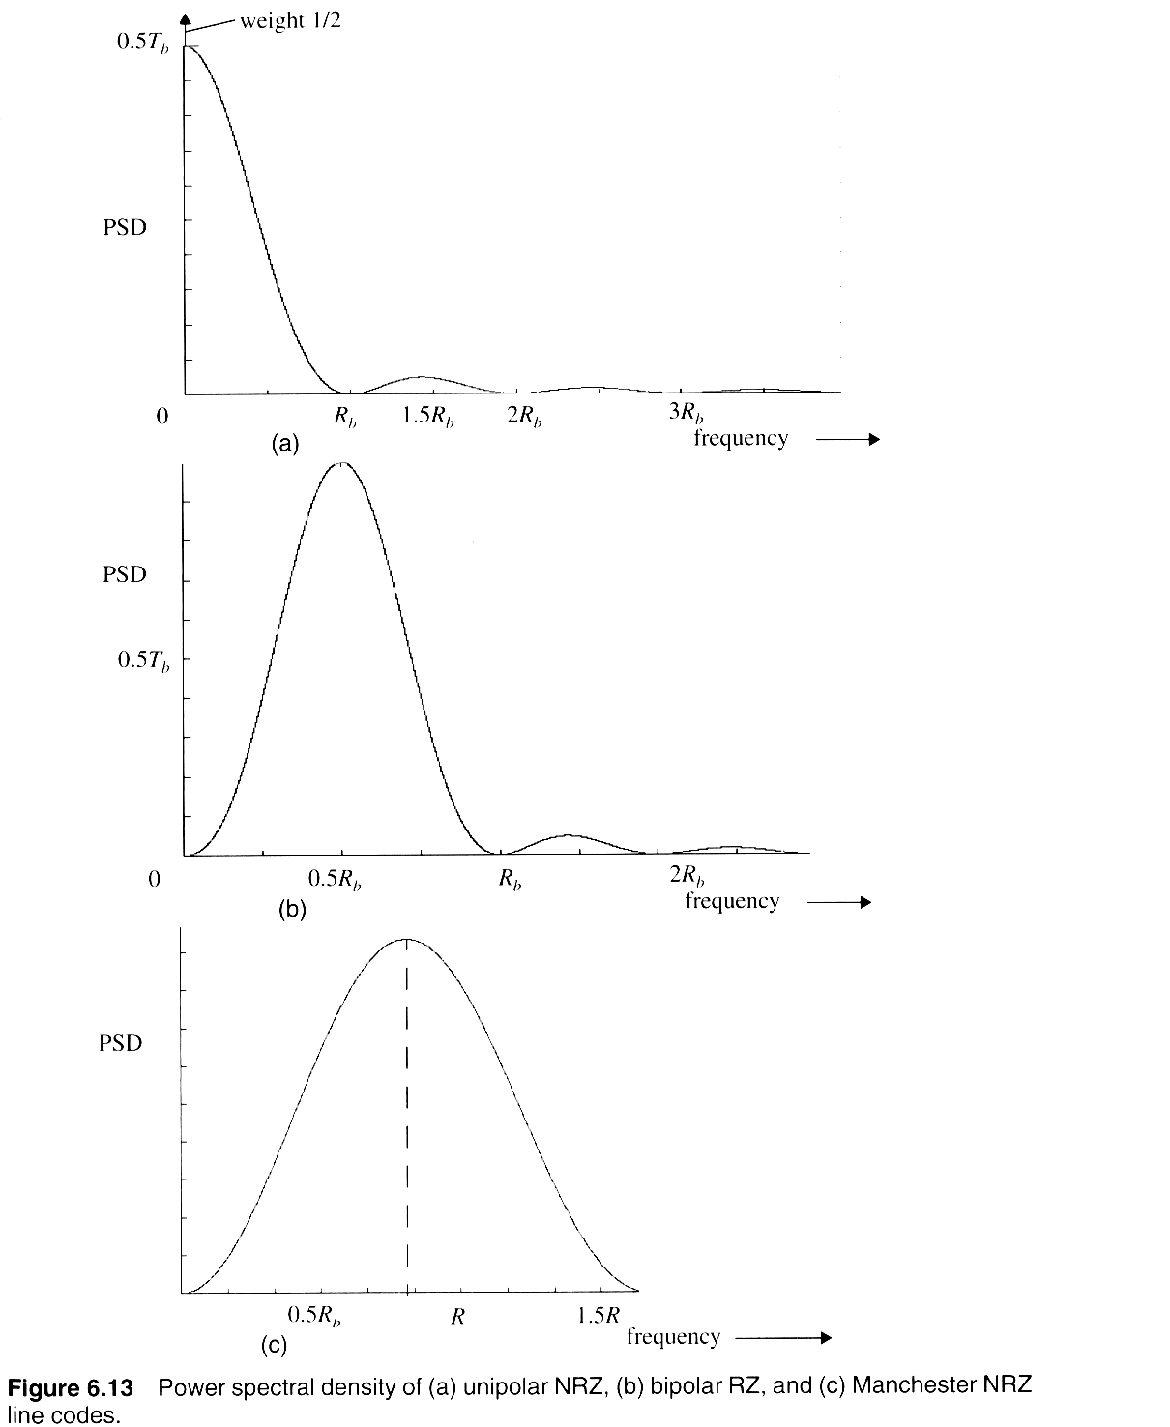
Line Coding spectra
Notes:
Fig. 2.10

Slide 19
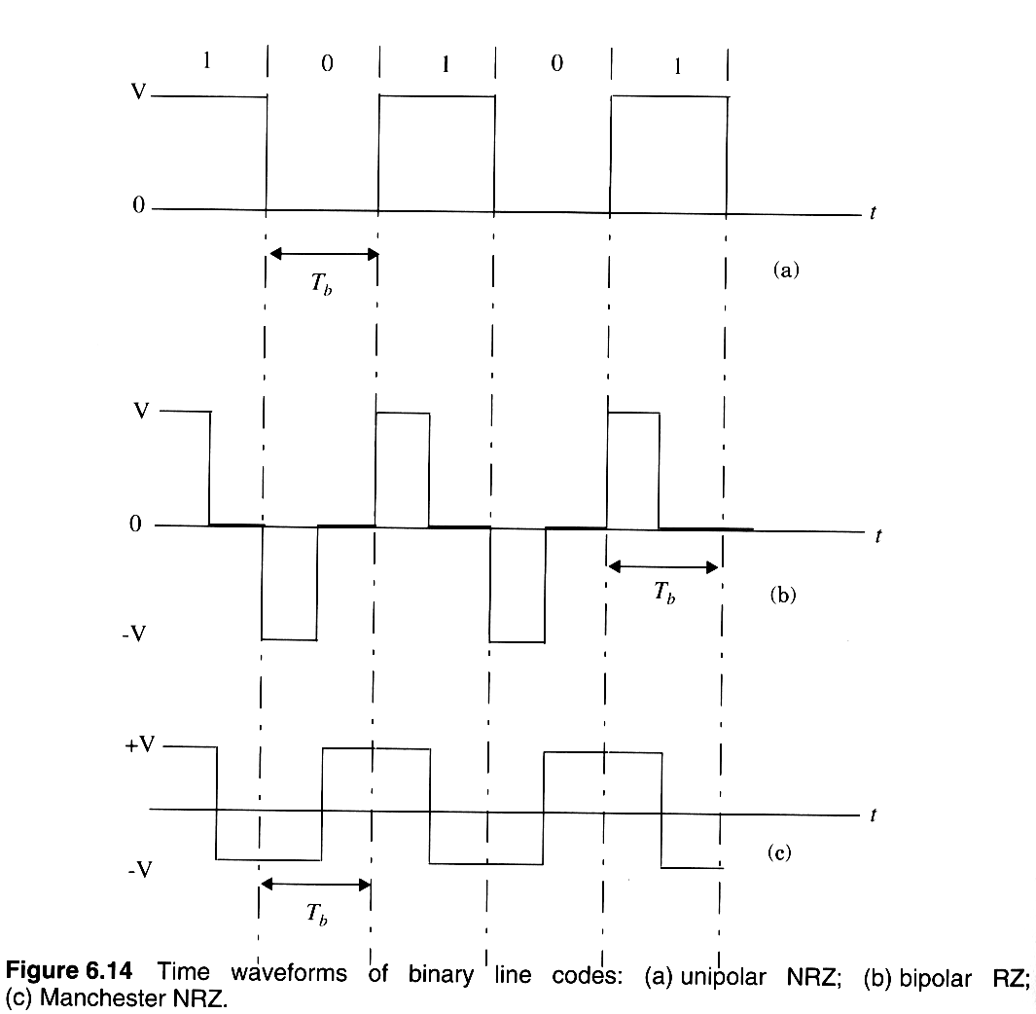
RZ and NRZ Line Codes
Notes:
Fig. 2.11

Slide 20
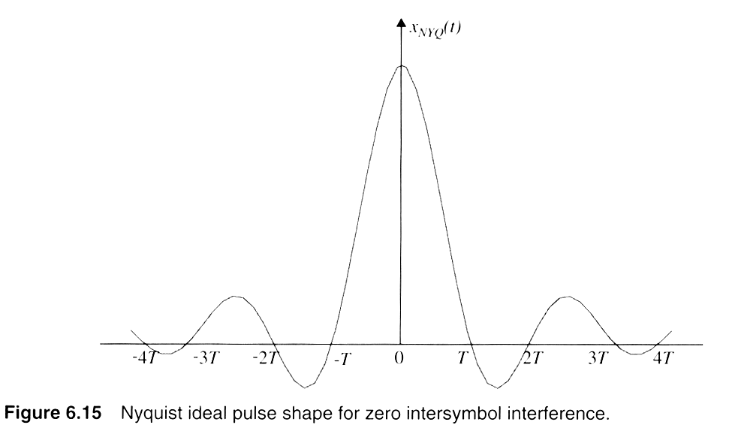
Nyquist Pulses for zero-ISI
Notes:
Fig. 2.12

Slide 21
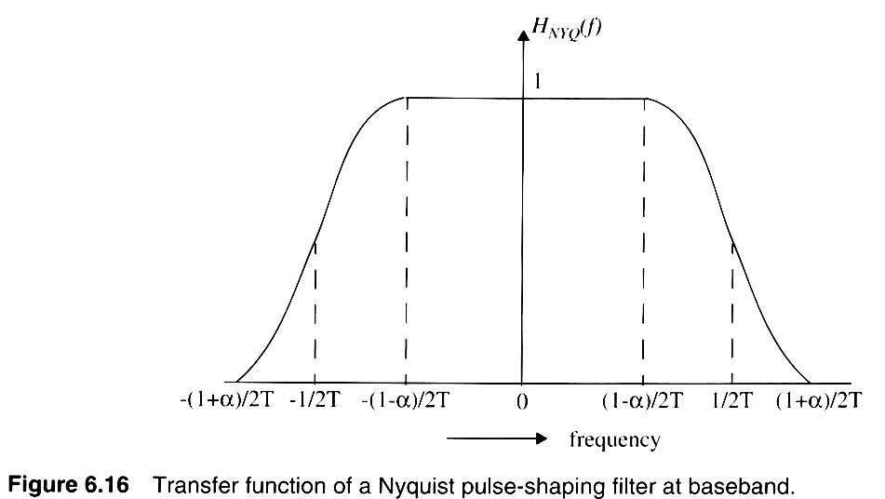
Raised Cosine Spectrum
Notes:
Fig. 2.13

Slide 22
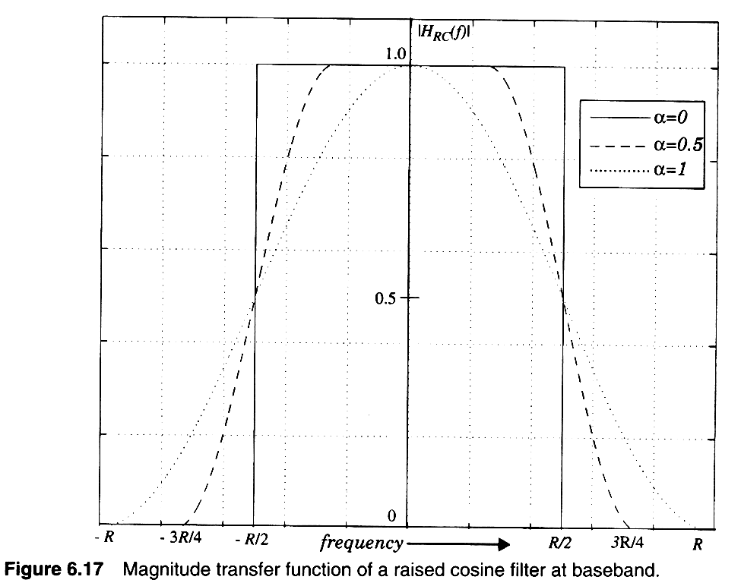
Spectrum of Raised Cosine pulse
Notes:
Fig. 2.13

Slide 23
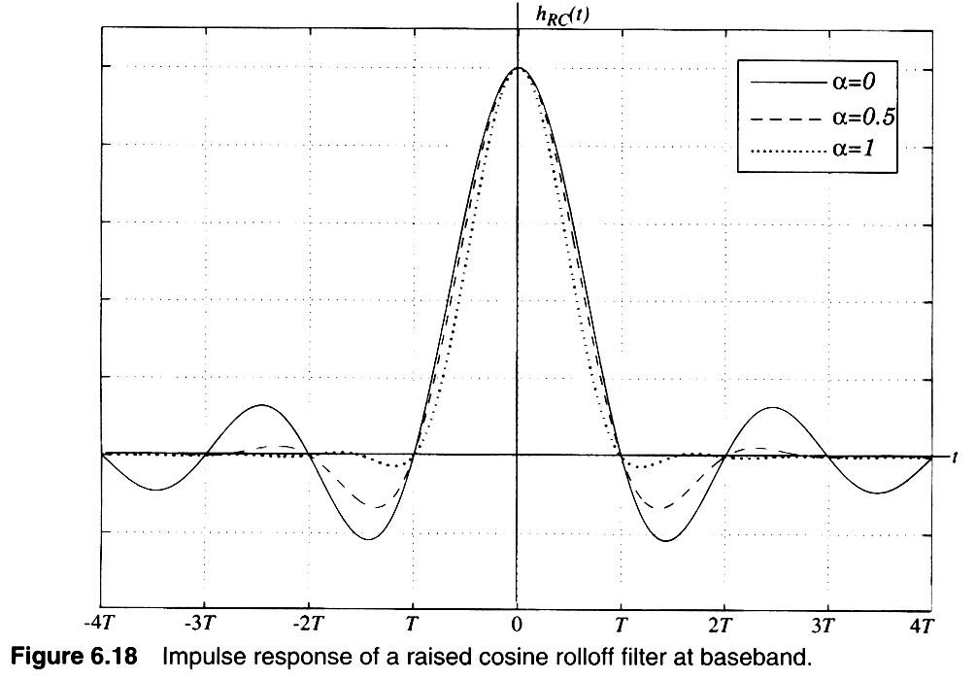
Raised Cosine pulses
Notes:
Fig. 2.14

Slide 24
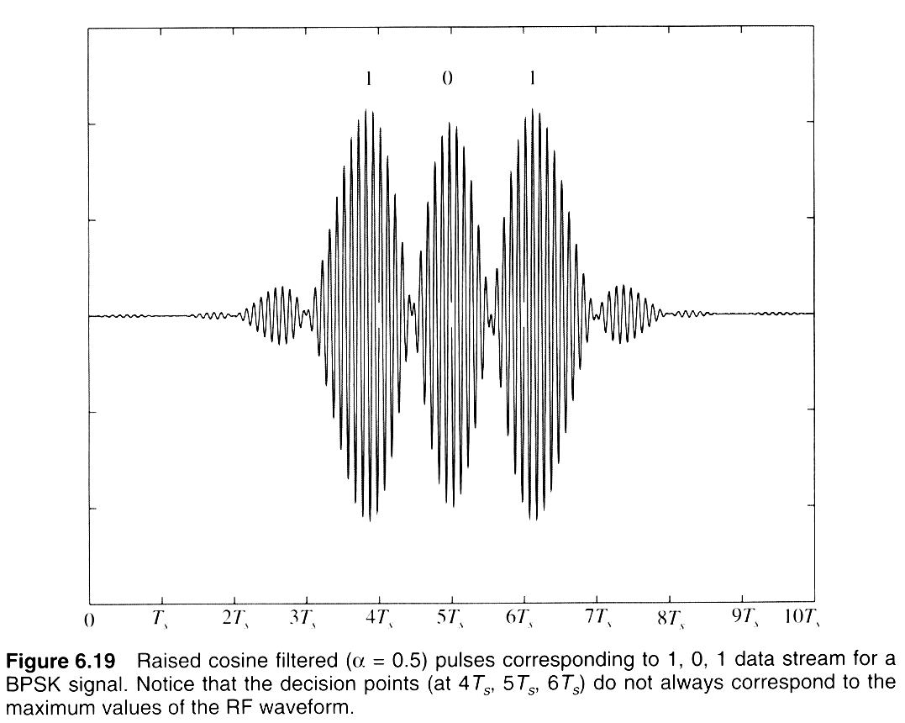
RF signal usig Raised Cosine
Notes:
Fig. 2.15

Slide 25
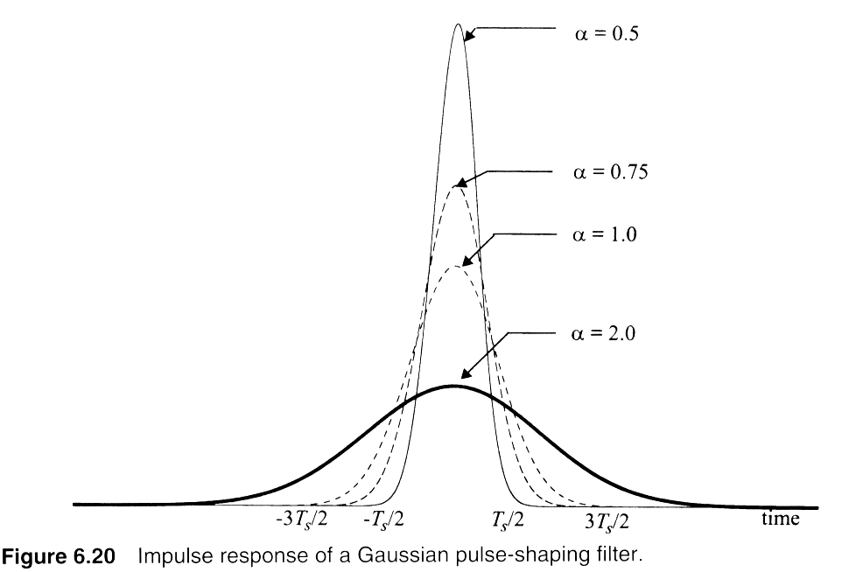
Gaussian pulse-shapes
Notes:
Fig. 2.16

Slide 26
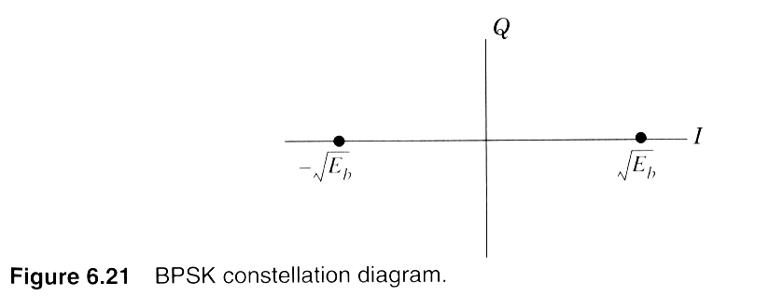
BPSK constellation
Notes:
Fig. 2.16

Slide 27
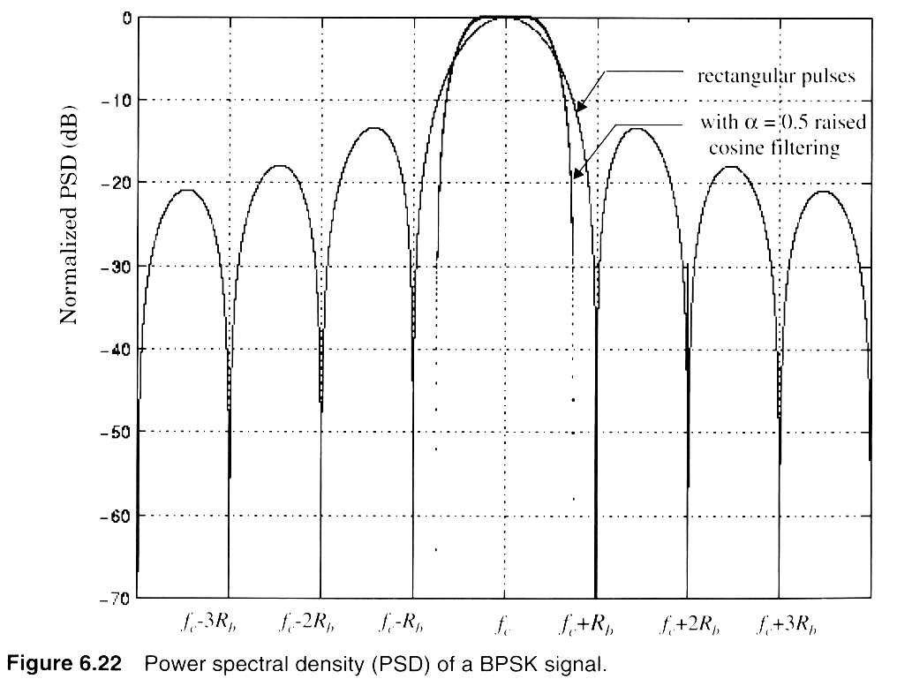
Virtue of pulse shaping
Notes:
Fig. 2.16

Slide 28
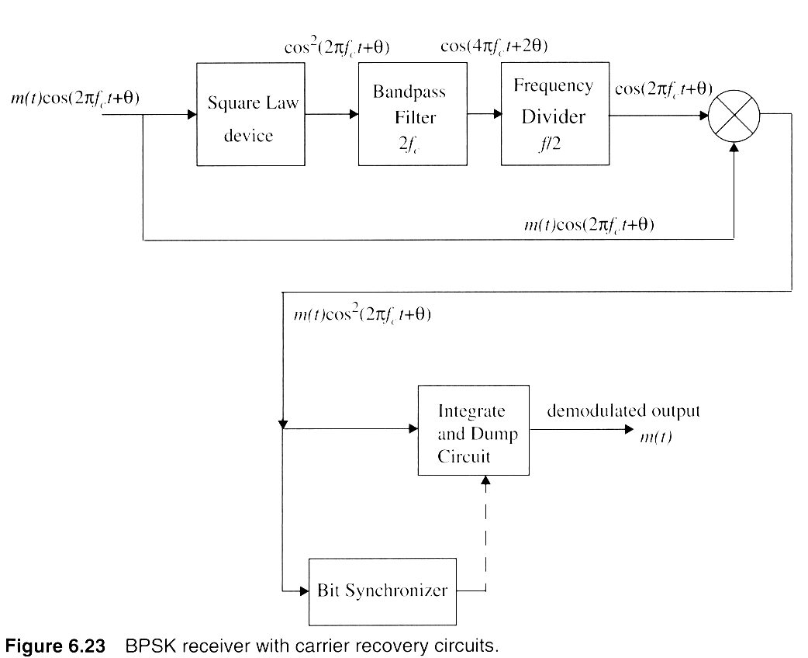
BPSK Coherent demodulator
Notes:
Fig. 2.16

Slide 29
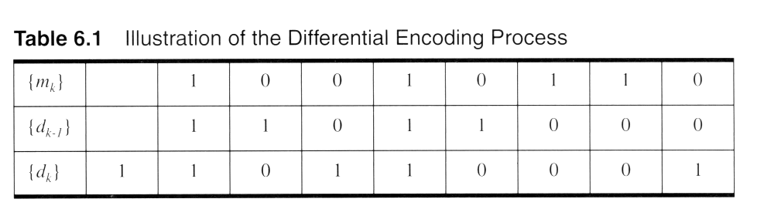
Differential PSK encoding
Notes:
Fig. 2.16

Slide 30
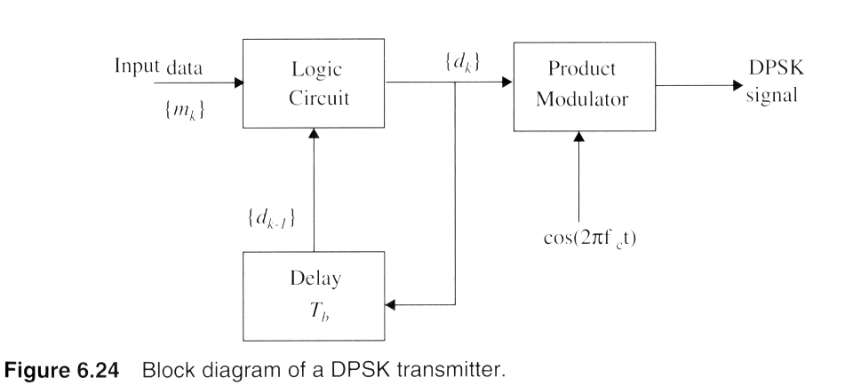
DPSK modulation
Notes:
Fig. 2.16

Slide 31
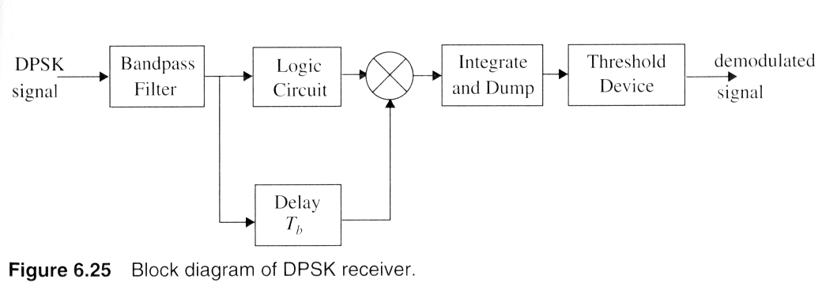
DPSK receiver
Notes:
Fig. 2.16

Slide 32
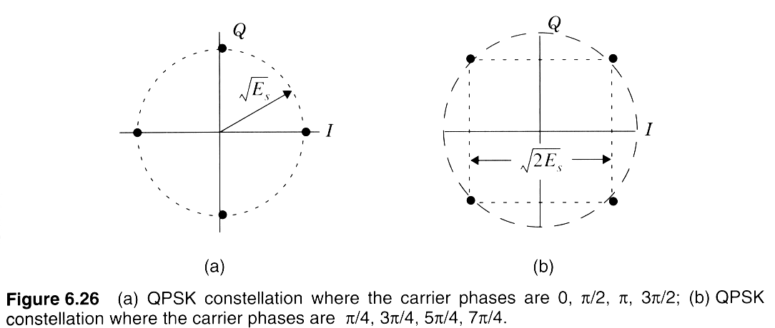
QPSK constellation diagrams
Notes:
Fig. 2.16

Slide 33
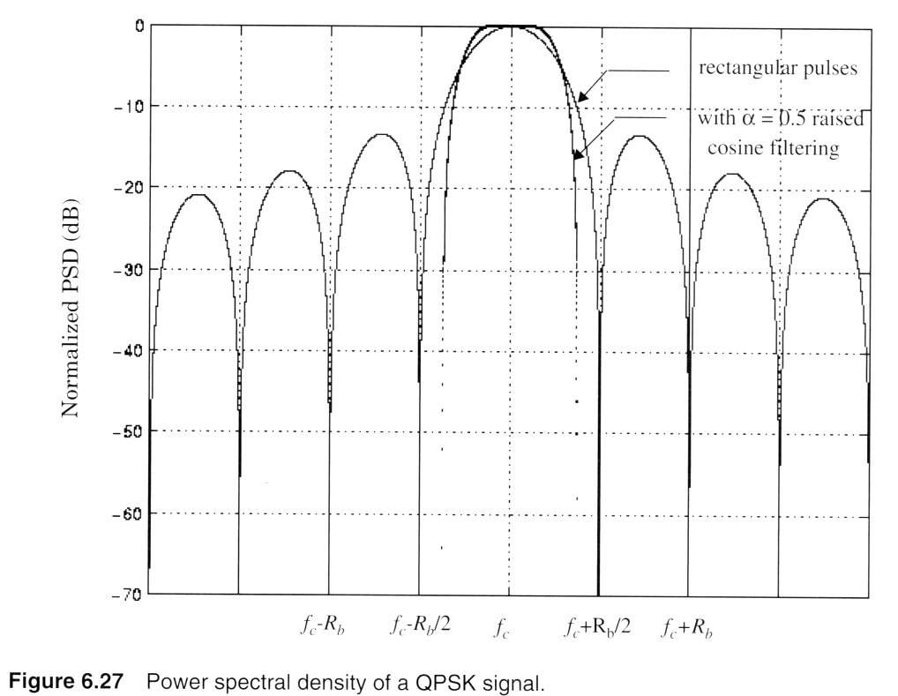
Virtues of Pulse Shaping
Notes:
Fig. 2.16

Slide 34
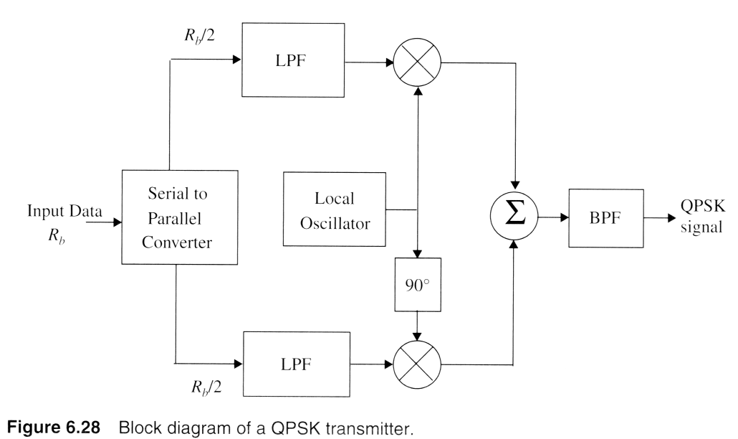
QPSK modulation
Notes:
Fig. 2.16

Slide 35
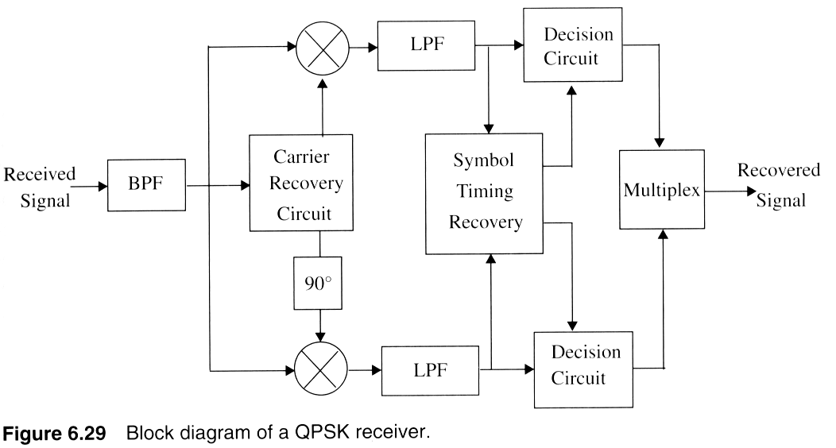
QPSK receiver
Notes:
Fig. 2.16

Slide 36
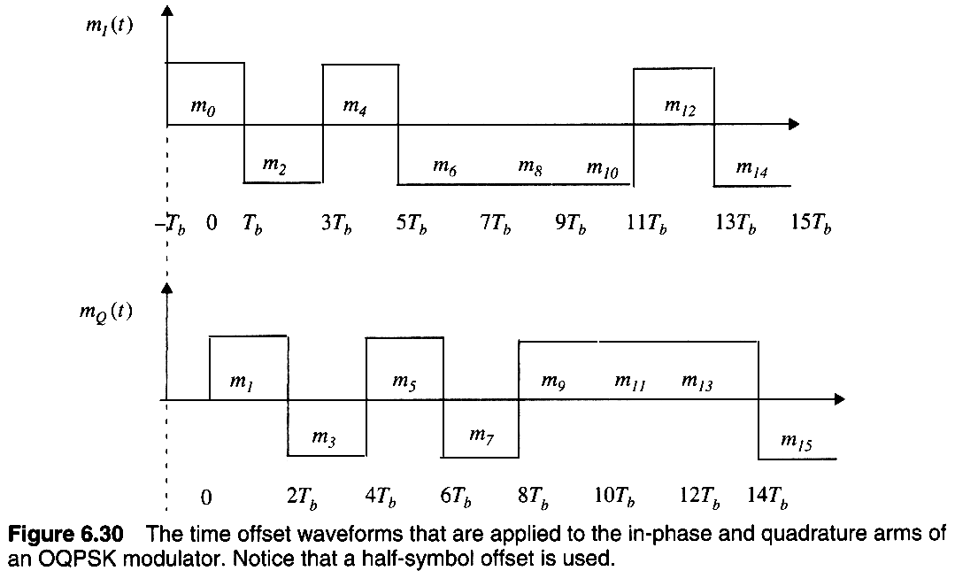
Offset QPSK waveforms
Notes:
Fig. 2.16

Slide 37
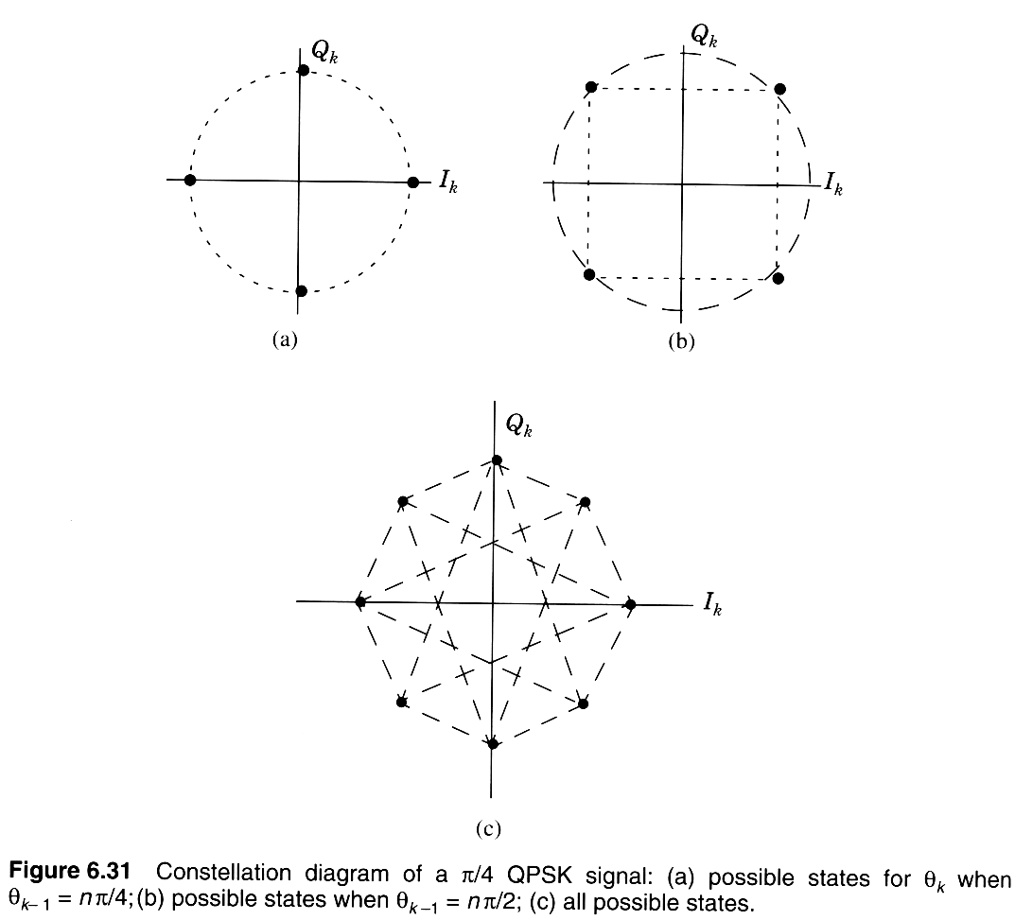
Pi/4 QPSK signaling
Notes:
Fig. 2.16

Slide 38
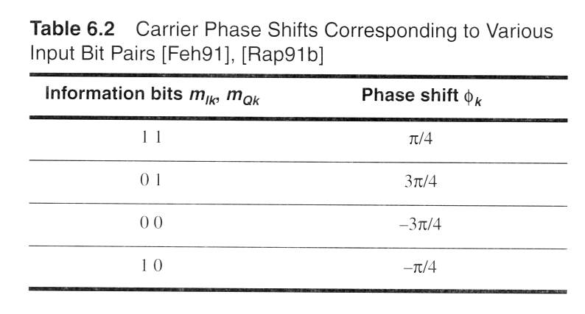
Pi/4 QPSK phase shifts
Notes:
Fig. 2.16

Slide 39
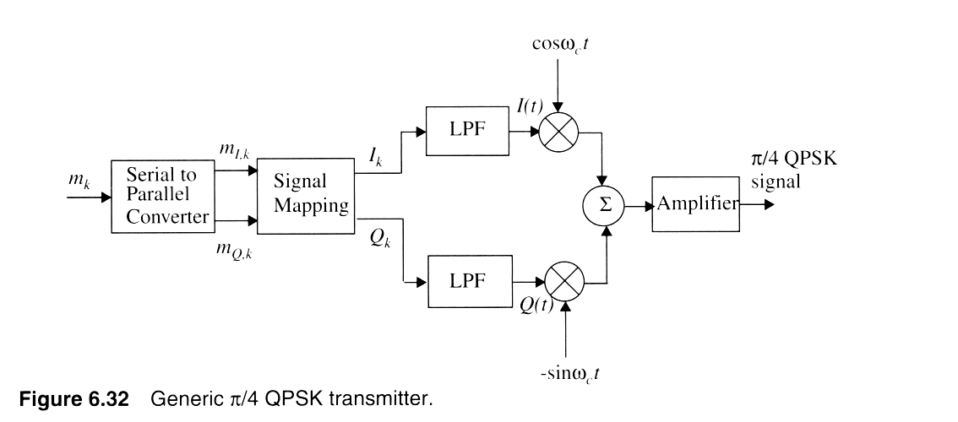
Pi/4 QPSK transmitter
Notes:
Fig. 2.16

Slide 40
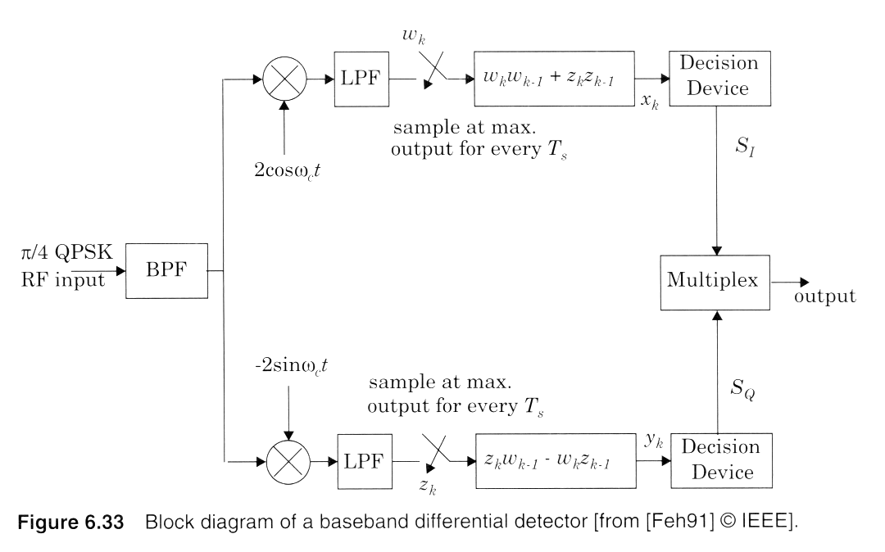
Differential detection of pi/4 QPSK
Notes:
Fig. 2.16

Slide 41
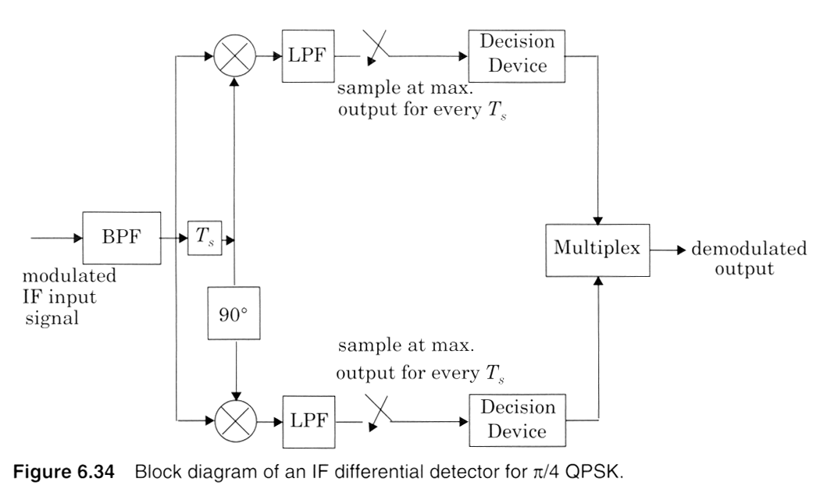
IF Differential Detection
Notes:
Fig. 2.16

Slide 42
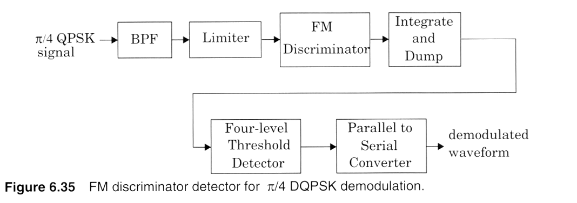
FM Discriminator detector
Notes:
Fig. 2.16

Slide 43
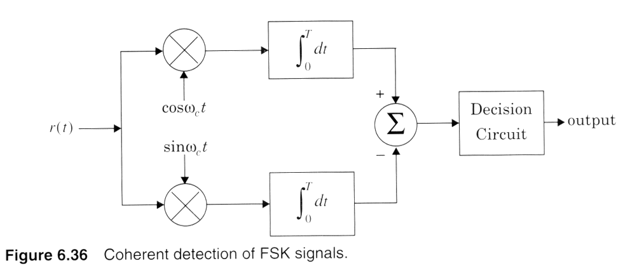
FSK Coherent Detection
Notes:
Fig. 2.16

Slide 44
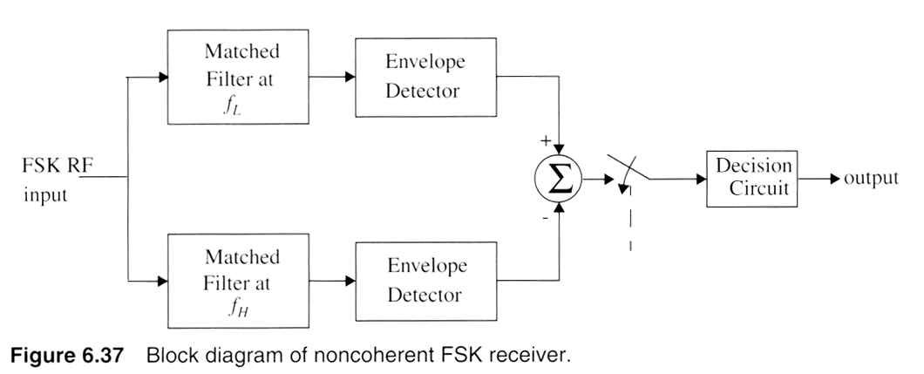
Noncoherent FSK
Notes:
Fig. 2.16

Slide 45
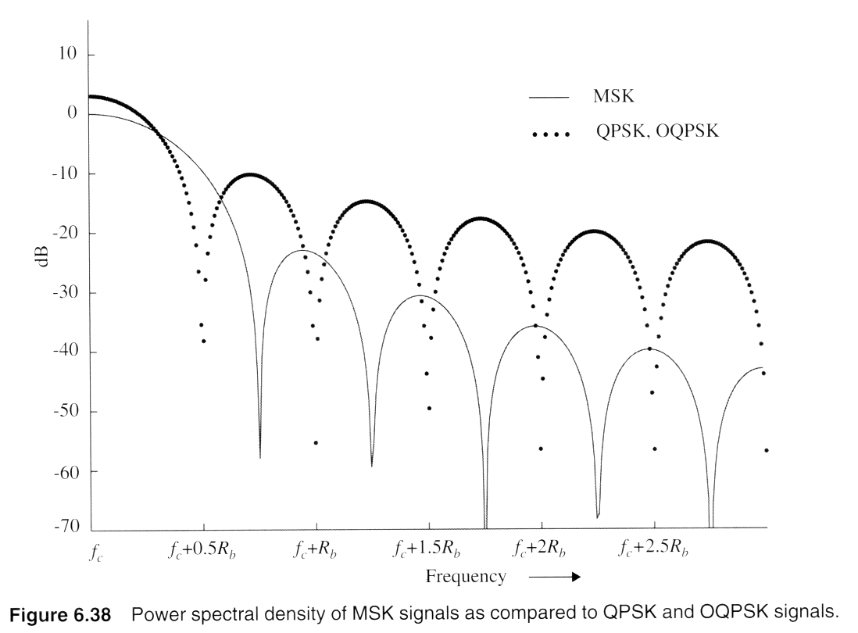
Minimum Shift Keying spectra

Slide 46
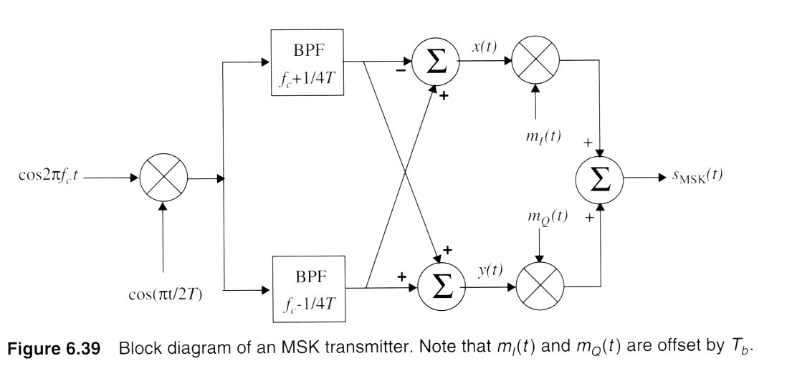
MSK modulation
Notes:
Fig. 3.2

Slide 47
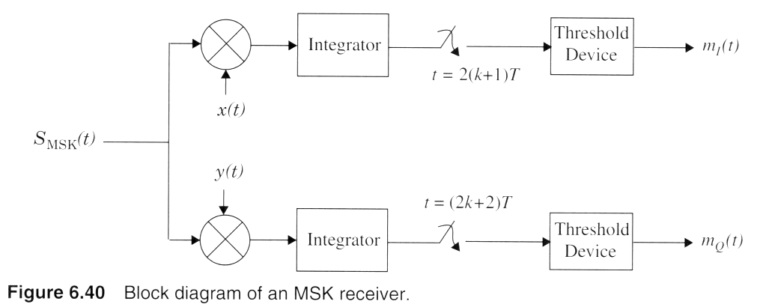
MSK reception

Slide 48
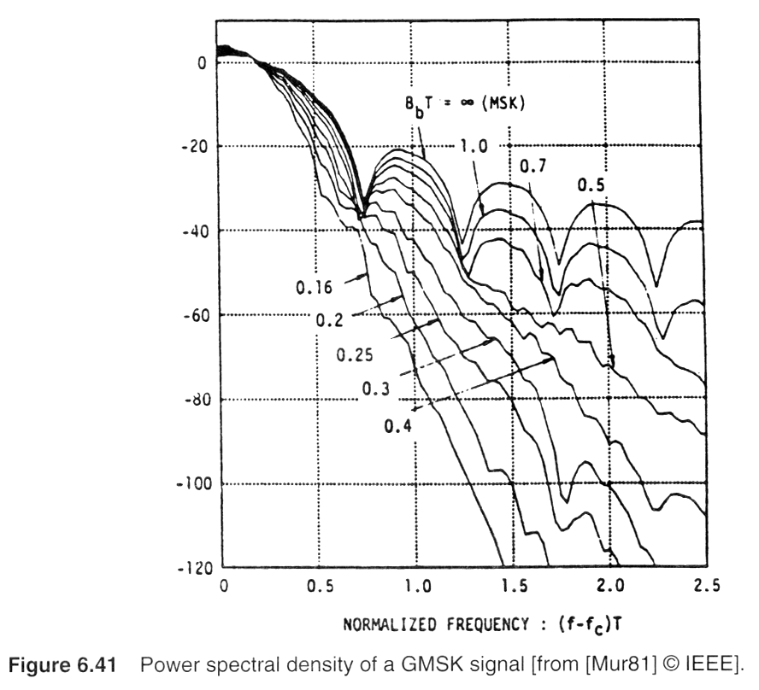
GMSK spectral shaping
Notes:
Fig. 2.3

Slide 49
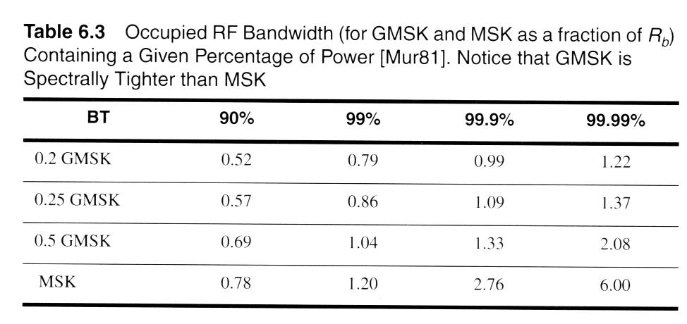
GMSK spectra shaping
Notes:
Fig. 2.16

Slide 50
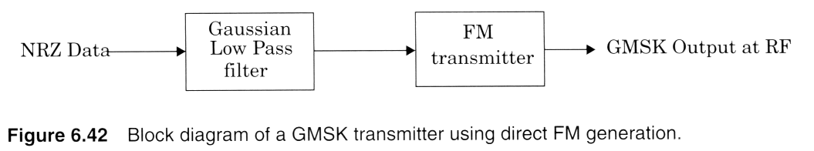
Simple GMSK generation

Slide 51
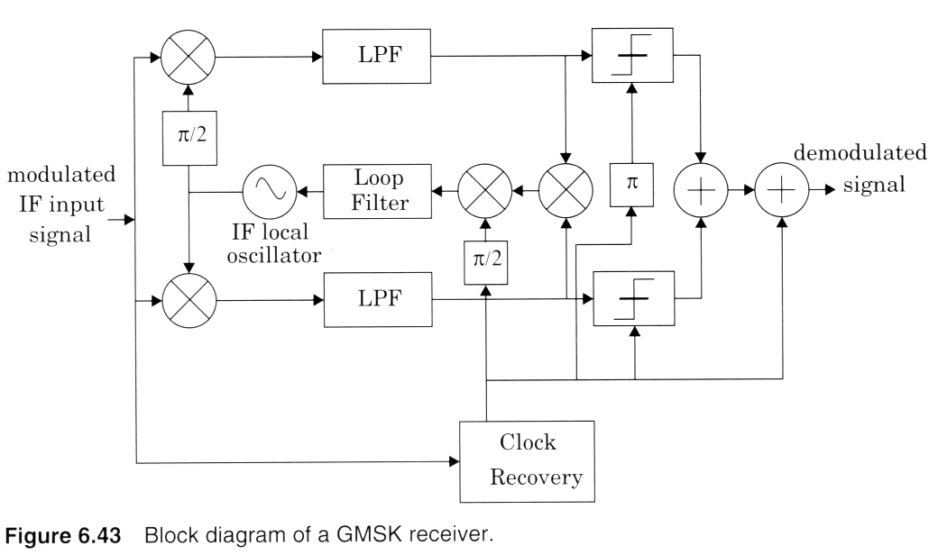
GMSK Demodulator

Slide 52
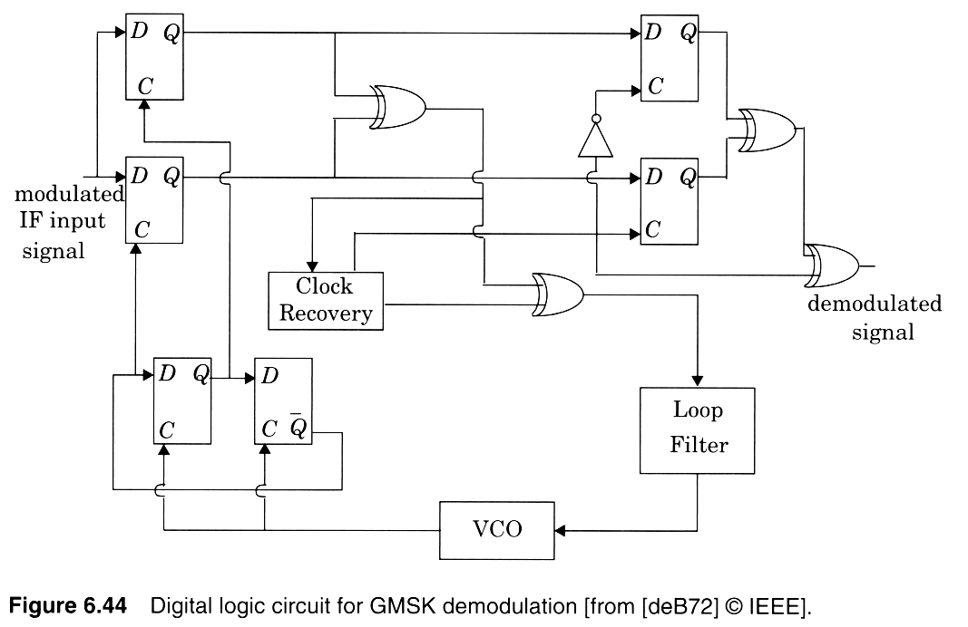
Digital GMSK demodulator
Notes:
Fig. 2.4

Slide 53
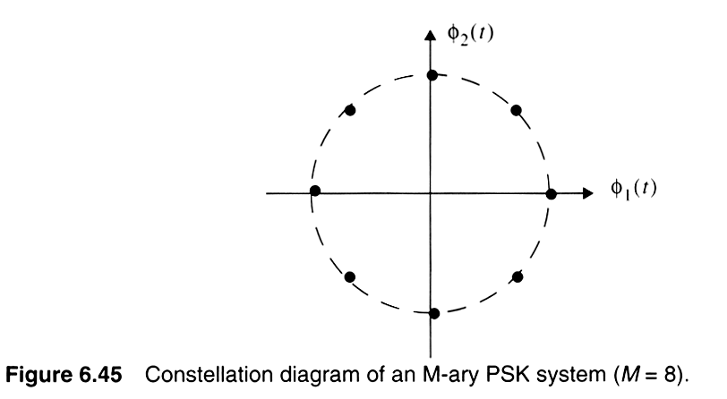
8-PSK Signal Constellation
Notes:
Fig. 2.5

Slide 54
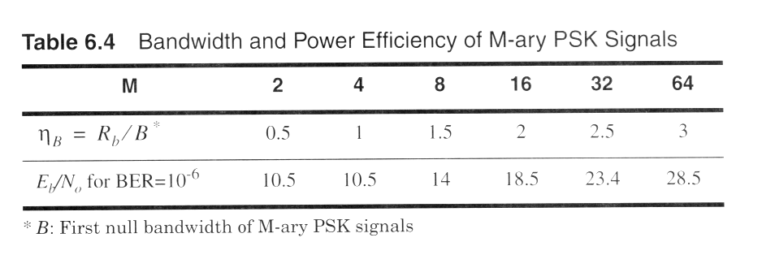
Bandwidth vs. Power Efficiency
Notes:
Fig. 2.16

Slide 55
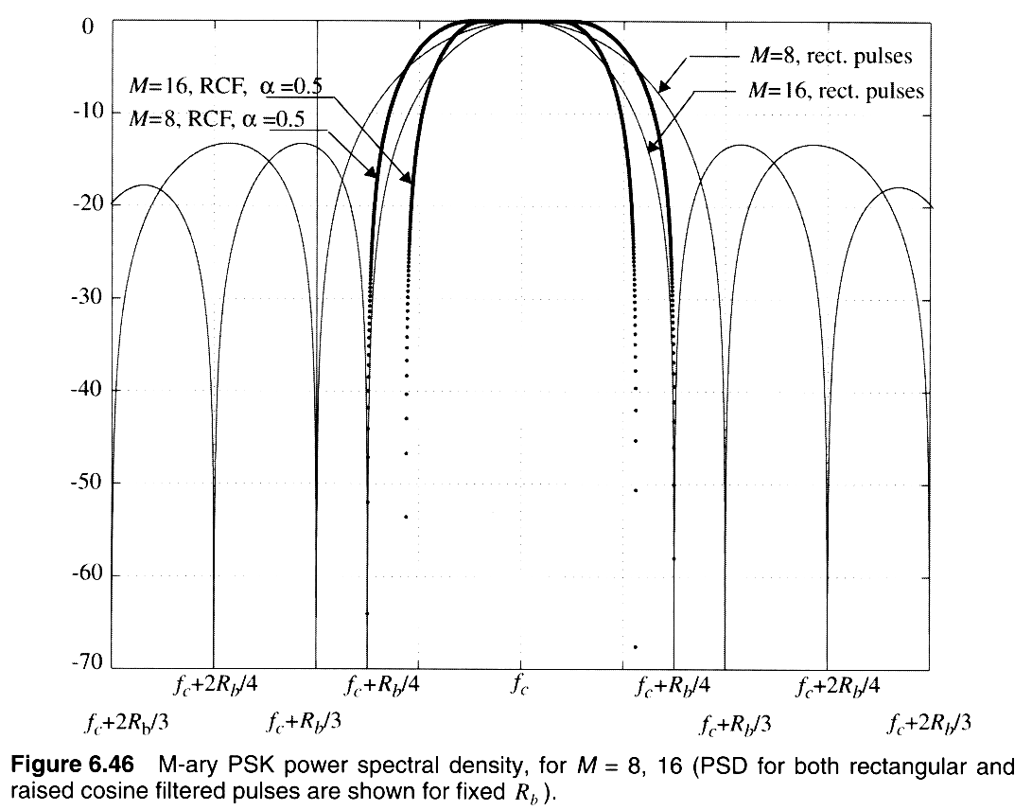
Pulse Shaped M-PSK
Notes:
Fig. 2.6

Slide 56

16-QAM Signal Constellation
Notes:
Fig. 2.7

Slide 57

QAM efficiencies
Notes:
Fig. 2.16

Slide 58

M-ary FSK efficiencies
Notes:
Fig. 2.16

Slide 59

PN Sequence Generator
Notes:
Fig. 2.8

Slide 60

Direct Sequence Spread Spectrum
Notes:
Fig. 2.9

Slide 61

Direct Sequence Spreading
Notes:
Fig. 2.10

Slide 62

Frequency Hopping Spread Spectrum
Notes:
Fig. 2.11

Slide 63

CDMA – Multiple Users
Notes:
Fig. 2.12

Slide 64

Effects of Fading
Notes:
Fig. 2.13

Slide 65

Irreducible Bit Error Rate due to multipath
Notes:
Fig. 2.14

Slide 66

Irreducible Bit Error Rate due to multipath
Notes:
Fig. 2.15

Slide 67

Simulation of Fading and Multipath
Notes:
Fig. 2.16

Slide 68

Irreducible BER due to fading
Notes:
Fig. 2.16

Slide 69

Irreducible BER due to fading
Notes:
Fig. 2.16

Slide 70

BER due to fading & multipath
Notes:
Fig. 2.16

